Slide 2
Driven to Distraction

Slide 3
DEFINITION
Distracted driving is the act of driving while engaged in other activities—such as looking after children, texting, talking on the phone or to a passenger, watching videos, eating, or reading—that take the driver’s attention away from the road -Wikipedia

Slide 4
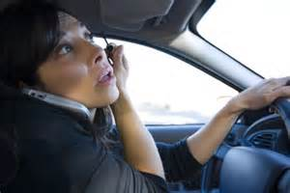
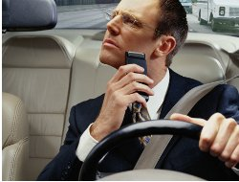
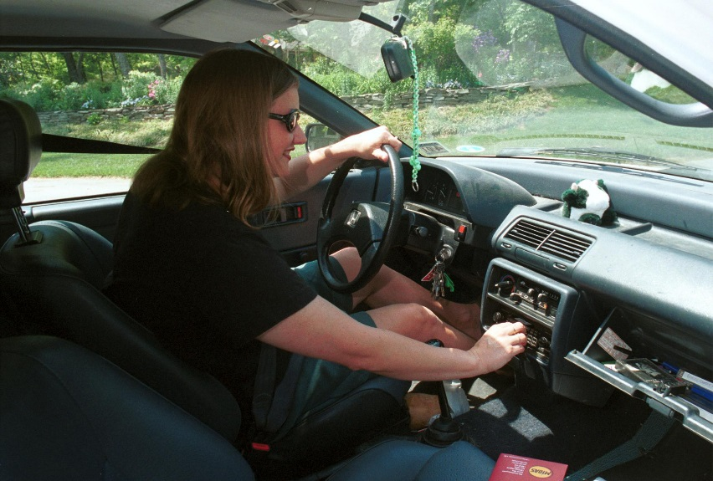
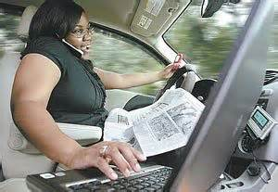
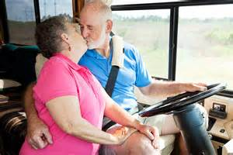
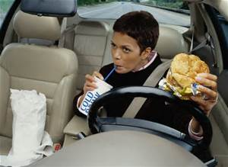
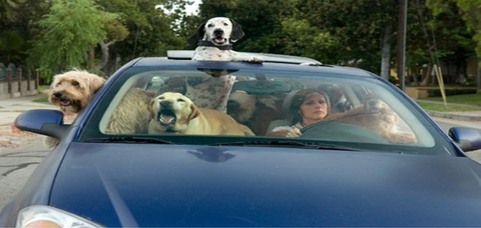
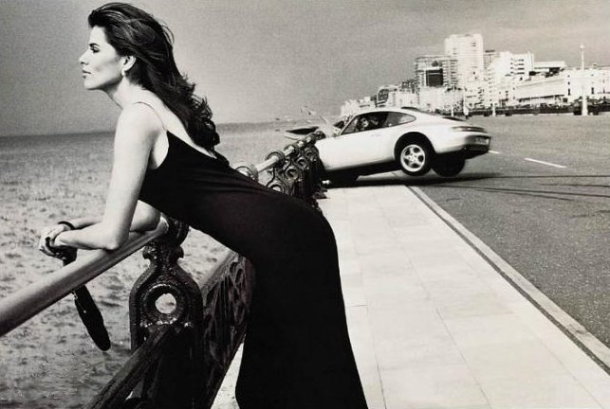
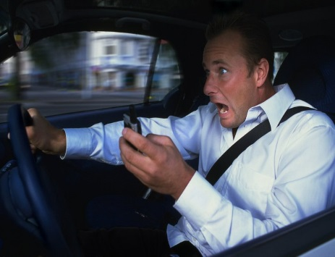

Slide 5
YOUNG DRIVERS
Alabama State Law
Novice Drivers, ages 16 and 17
holding a license for less than
six months, are
BANNED from cell phone use
NO handheld and NO hands-free

Slide 6
NO TEXTING
Texting While Driving is
BANNED within the entire State of Alabama

Slide 7
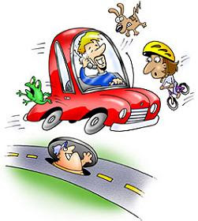
DEATHS
2013
3,154 were killed
in distracted driving crashes

Slide 8
INJURIES
2013
424,000 were injured
in distracted driving crashes

Slide 9
Cognitive Distractions
Voice commands are a cognitive distraction.
When you give voice commands to the in-car infotainment system, you can keep your eyes on the road, and you don't have to push any buttons with your fingers, but your brain isn't focused on the act of driving itself. This is because cognitive distractions may cause inattention blindness, which prevents you from seeing things that are in your field of vision.

Slide 10
Speech-to-Text
Using a speech-to-text system can be complicated because you must concentrate to enunciate correctly in order to dictate a text the system will understand.
Some systems require drivers to dictate words or phrases letter by letter. Other systems can't function properly if there is noise in the car.

Slide 11
Don’t do it!

Slide 12
Drivers Texting
Observational surveys
show that
more than 100,000
drivers are texting
at any given daylight moment.

Slide 13
Phones
More than 600,000 drivers are holding phones to their ears while driving

Slide 14
Phones = Distraction
According to a study from the
National Highway Traffic Safety Administration,
making or accepting phone calls while driving accounts for 40% of distracted driving.

Slide 15
Driving Blindfolded
Texting takes your eyes off the road for 4.6 seconds.
At 55 MPH, that’s like driving an entire football field blindfolded
Cell phone use was reported in 18% of
distraction-related fatalities in America

Slide 16
Exposure
Employers who expect employees to use cell phones while driving as part of their business must recognize that doing so exposes their employees to preventable crash risk.
Consider a situation in which an employer knew a behavior in some area of its operations exposed employees to a four times greater risk of injury. Would employers still expect or even encourage that behavior? That is precisely what happens when an employer permits or even encourages employee cell phone use while driving.

Slide 17
EMPLOYERS
Employers
are now being held
LEGALLY RESPONSIBLE

Slide 18
Take Action
EMPLOYERS NEED TO:
Educate employees
Monitor compliance
Enforce the policy
Address violations

Slide 19
Lawsuit
Understand
what you may face during
LEGAL DISCOVERY

Slide 20
Negligence
A victim’s attorney’s job is to demonstrate the factors that led to negligence.
In cases involving an employee in which any aspect of the crash scenario was workplace-related, a smart lawyer will follow the trail of evidence. This trail will lead not only to the employee, but to the employer as well. This is the legal discovery process.

Slide 21
Discovery Process can show:
Driver cell phone records revealing the amount of time during the workday when the employee is using the phone
Cell tower records where the calls begin in one location and end in another, thereby proving cell phone use while driving
Texting records which may even include the actual texts
Telemetric records which correlate with the phone records to provide an accurate picture of this risky behavior
Details about the employer’s cell phone policy, and the extent of its policy implementation and enforcement

Slide 22
Protect Yourself AND Your Company
Employers can never be 100% protected in the event of a lawsuit. However, if employers can show that they implemented a total ban policy, educated employees, monitored compliance and enforced the policy, they will be in a more defensible position than if they had not followed these practices.

Slide 23
Dollars and Cents
While responding to a crash, an Illinois state trooper was speeding at more than 120 mph on an interstate freeway, talking on a cell phone to his girlfriend and using email before he lost control of his squad car and crossed over the median.
The crash instantly killed two teenage sisters in the first vehicle, which was hit head-on, and injured a couple in another vehicle. The family of the sisters was awarded $8 million, and the other family was awarded $700,000 by the State Court of Claims.

Slide 24
Dollars and Cents
The city of Palo Alto, California agreed to pay a $1.45 million settlement to a crash victim left with permanent, debilitating spinal injuries after being struck by a city worker who was reaching for his cell phone while driving. The injured man’s vehicle was rear-ended at a red light.

Slide 25
AMIC/MWCF Video Library
Videos/DVDs covering a wide variety of public sector safety, health, and liability issues
Approximately 450 selections
Online Video Catalog on website
Rachel Wagner, DVD Librarian
Our Safety Video Library list is searchable in PDF form

Slide 26
5.004-VHS City Driving, 5 minutes
5.005-VHS City Driving Tactics: 2nd Edition, 20 minutes
5.011-VHS Driving Defensively 1, 5 minutes
5.012-VHS Driving Defensively 2, 5 minutes
5.016-VHS Good Driving is an Attitude, 5 minutes
5.048-VHS Driving Safety, 13 minutes
5.049-VHS Driving Distractions of the Professional Driver, 17 minutes
5.049-DVD Driving Distractions of the Professional Driver, 17 minutes
5.052-VHS Why Do We Drive the Way We Do? 11 minutes
5.055a-DVD Distracted Driving: At What Cost? 14 minutes
5.055b-DVD Distracted Driving: At What Cost? (Concise Version) 10 minutes
5.056-VHS Safe Driving Tactics: The Blindfold Effect (Distracted Driving) 18
5.059-DVD The Extreme Driving Quiz, 46 minutes
5.063-DVD Defensive Driving for Government Employees, 19 minutes
5.067-DVD* Distracted Driving (Focus on Texting and Driving) 19 minutes
5.068-DVD* Distracted Driving: 15-Passenger Vans, 19 minutes
5.069-DVD* Defensive Driving: When Good Weather Goes Bad, 16 minutes
5.070-DVD* Driving Distractions of the Everyday Driver, 18 minutes

Slide 27
Website Resources
For sample policies:
www.losscontrol.org
Click on Reference Documents

Slide 28
Website Resources
Groups looking to raise awareness
can visit
Distraction.gov
for specific suggestions and tools
they need to help end distracted driving
in communities nationwide

Slide 29
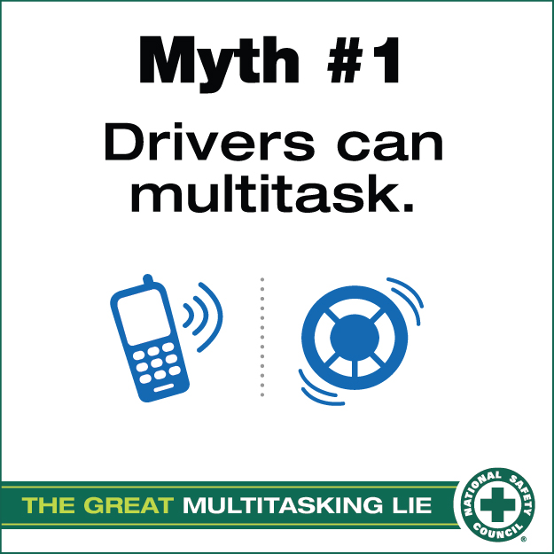

Slide 30
losscontrol.org
Stephanie J. Southerland
334.462.0150
stephanies@alalm.org

Slide 31
Questions?

